Slide 1
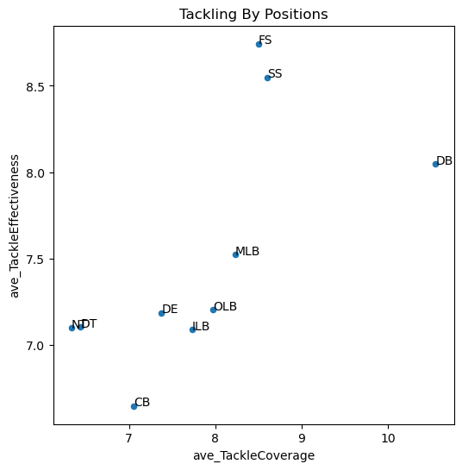
Ineffective
Chasing
Efficient
Athletic

Slide 2
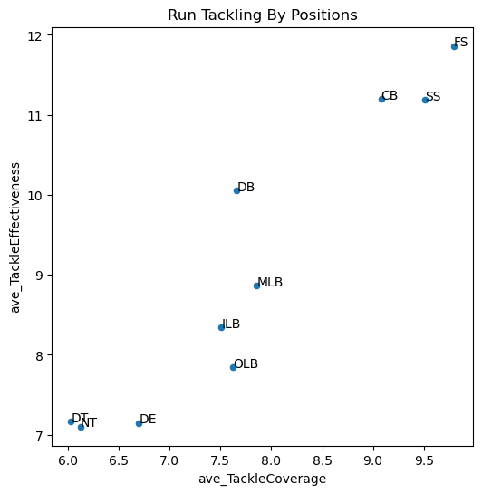
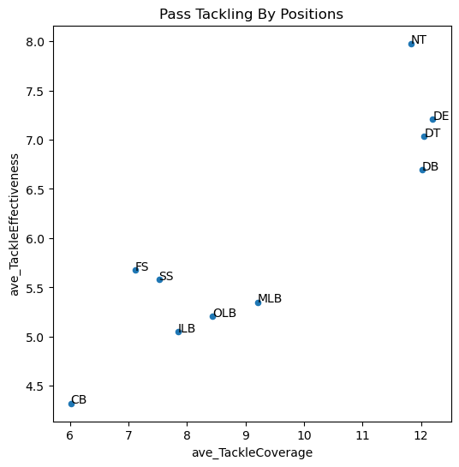
Ineffective
Chasing
Ineffective
Chasing
Efficient
Athletic
Efficient
Athletic

Slide 3
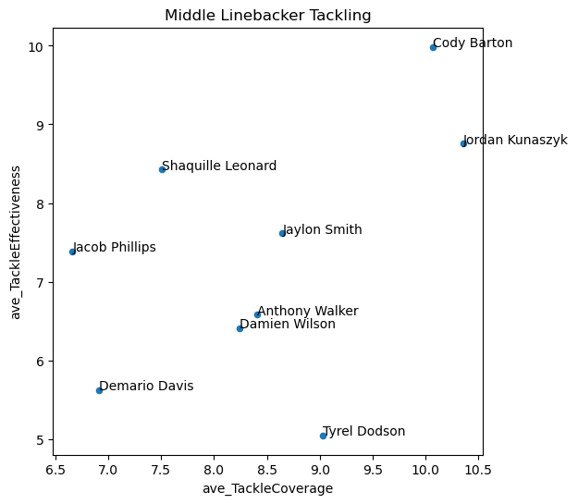
Ineffective
Chasing
Efficient
Athletic

Slide 4
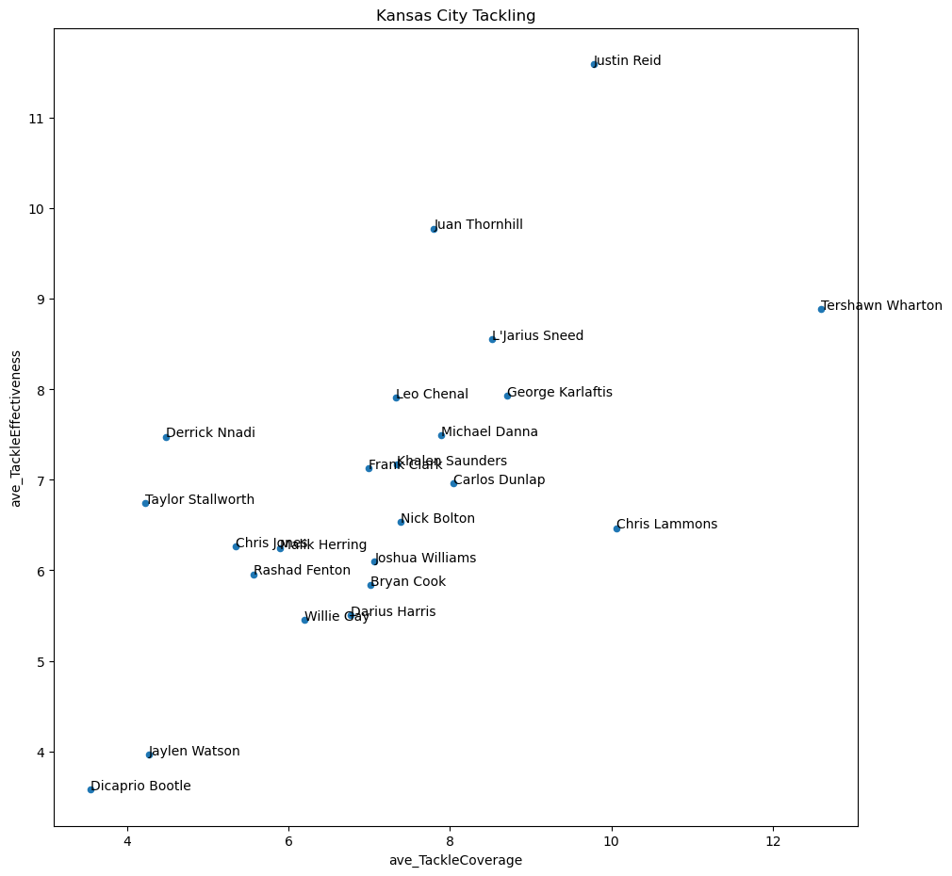
Ineffective
Chasing
Efficient
Athletic

Slide 5
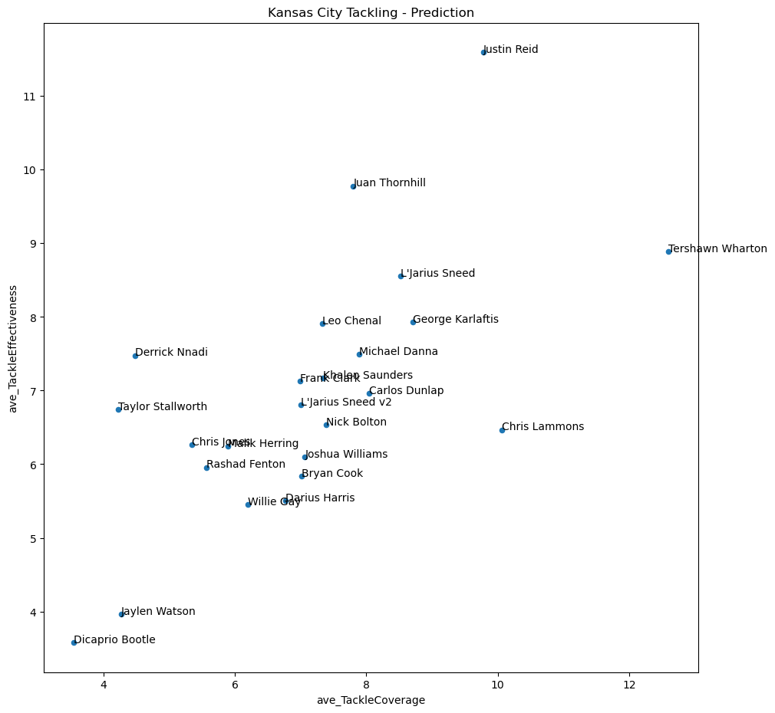
Ineffective
Chasing
Efficient
Athletic

Slide 6
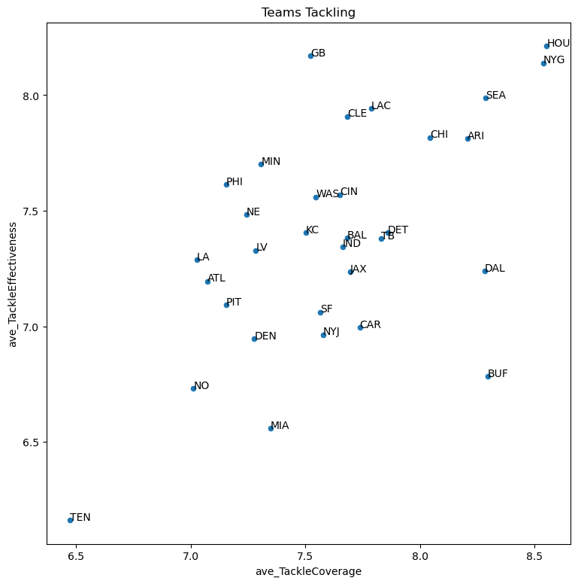
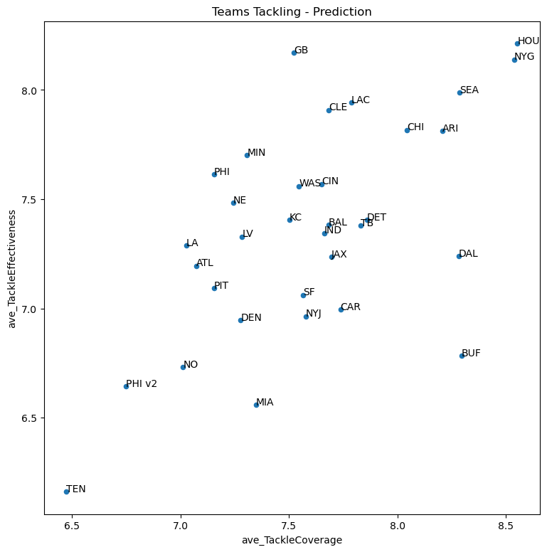
Ineffective
Chasing
Ineffective
Chasing
Efficient
Athletic
Efficient
Athletic

Slide 7
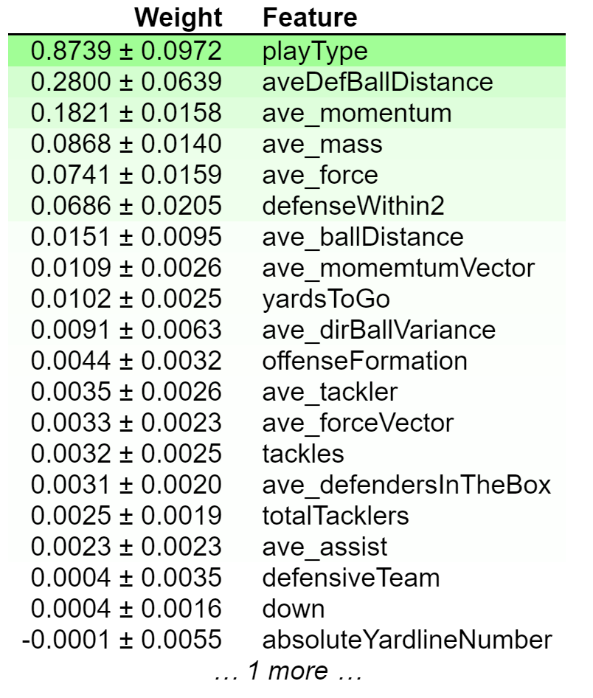
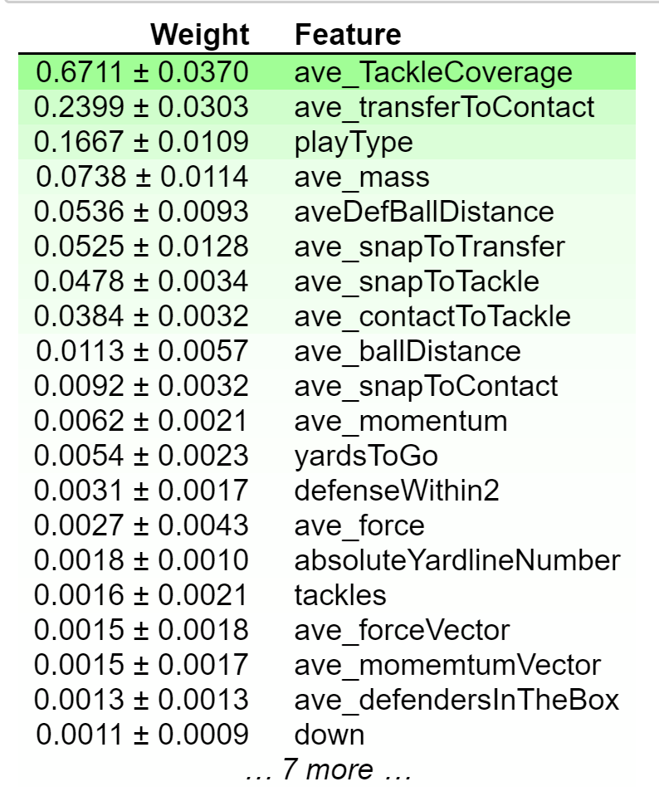

Slide 8
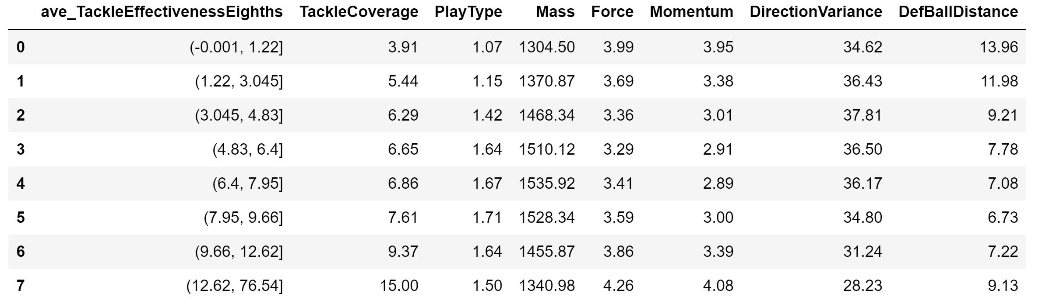

Slide 9
